Slide 1


Introduction of Banking Data Warehouse
Sky Zhang
zhkzhang@cn.ibm.com

Slide 2
Agenda
Data Warehouse Instruction
1) Data Warehouse Project background
2) Data Warehouse Architecture
3) Data Warehouse application
FS-LDM
Single Customer View
Data Mart Instruction
1) Unica Data Mart
2) CRM Data Mart
Big Data Instruction

Slide 3
Part 1 Data Warehouse Instruction

Slide 4
Data Warehouse System Background
Page 4
Application Name: Group Data Warehouse(GDW)
Banking data warehouse application
Client Server and HOST architecture

Slide 5



Information Architecture
Systems
Data Integration
Data Warehouse
Analytics
Users
Systematics/Finacle
Business Intelligence
Extract
Detailed and Summary Data
Analyze
Reporting
Avaloq
Cleanse
Staging
Data Warehouse
Query
Standardize
Vision Plus
Transform
Analysis
Dashboards
IBR
CRM
Data Mart
Unica
Data Mart
Event/
Notification
Leaps
EPRC
Data Mart
Basel III
Data Mart
Predictive
Analytics
……
Business Glossary
Text files/manual file
Meta Data

Slide 6
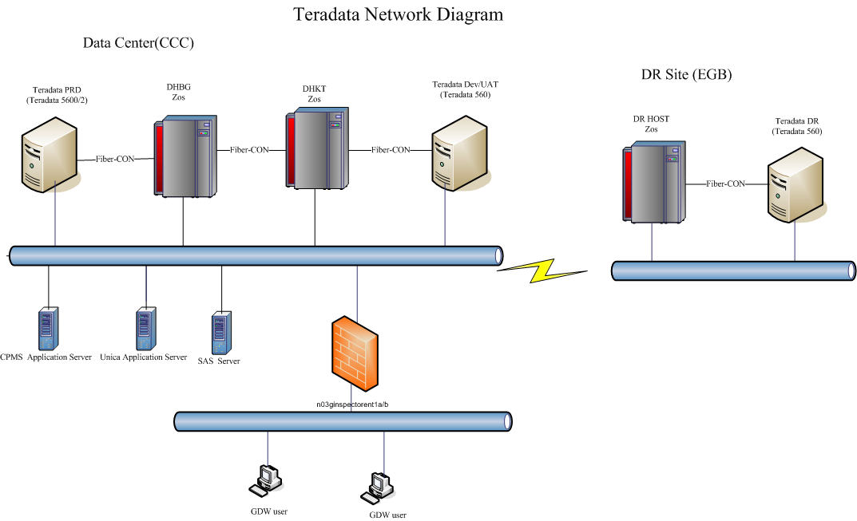

Slide 7
Data Warehouse Application
FC
LEAPS
CBDINV
FinIQ
BOSS
CD Staging
CBHKSS
MUREX
VGI
CPMS
TMS
MLI
TMS
AVQ
CBHKSS
ATMH
CONNOM
HKCOLS
BIP(AVQ)
B2SAS
CEP
BIP(CCP)
Gweb
GDW
GCG
BIP(FIN)
ITS
LAM/LRE/CCP
BIP(IPE)
User
BDW
BIP(IB)
BIP
BIP(KONY)
AVQ
GMI
BIP(SOI)
BNK
GUT
GAS
CCP
LRM/LRE/LAM/LCL/LTS
Vplus (UL)
GB2
TZ
GFU
GCI
RE3
IMEX
CDM
FPRO
Smart Workstation
……

Slide 8
ETL Time Schedule
03:30
07:00
17:00
18:00
23:55
6:00
12:00
23:00
00:00
Banking loading
GDW
Credit Card
Single view
Backup Tables
GAS
Unica& EPRC
CRM

Slide 9
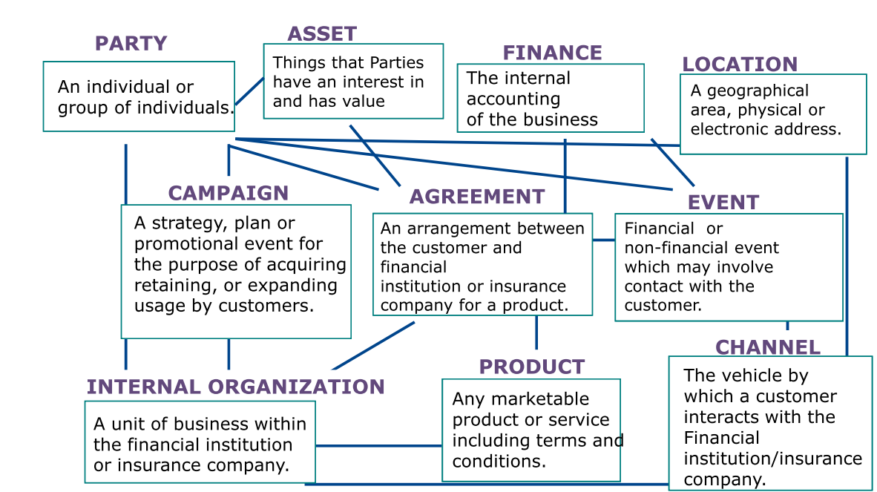
FS-LDM

Slide 10
Overview of ‘TL’ in GDW
Pre-Processing
MCIF
LOAD
LOAD
MCIF
E
T
T
L
Multi-Load
Post-Processing
Interface Files
Extraction
Transformation
Loading
Source
System
GDW

Slide 11
High level job flow diagram
DHBG-BATCH-START
Generate single view
DHBG-READY
Generate interface for other
GDW batch begin
systems
Run Prepare Job
Housekeeping
Copy interface from other
Backup interface and
systems
DB
Load data into GDW
GDW batch end

Slide 12
Interface File Type (Basic)
Full Set (e.g. Account Master)
All records, even there is no change
Simple extraction by source system
Daily Delta (e.g. Transactions)
Only records changed for the day
Need to log changes in source system
Potential miss in capturing of change

Slide 13
Interface File Type (Adv.)
Cycle Delta (e.g. Credit Card Accounts)
Daily Delta, PLUS
Full Set if falls on cycle date
Automatic synchronization
Extended Delta
Daily Delta for last consecutive days, say 7 days
Automatic recovery from daily failure

Slide 14
Input File Validation
Header/Trailer Record
Header date against processing date
Record count against processed detail records
To detect
Input files not updated
File integrity error due to file transfer failure

Slide 15
TL: Update MCIF
Empty MCIF.xx
Copy from LOAD.xx to MCIF.xx
Collect statistics on MCIF.xx
Update job status to RUN_CONTROL

Slide 16
Load - Replace
Complete replacement
Logic
Empty LOAD
Multi-load into LOAD
Replace MCIF from LOAD
Empty MCIF
Copy LOAD to MCIF

Slide 17
Load - Append (Small)
Applicable for small tables
Logic
Copy MCIF to LOAD
Multi-load into LOAD (Insert)
Replace MCIF from LOAD

Slide 18
Load - Append (Large)
Applicable for large tables
Logic
Empty LOAD
Multi-load into LOAD
Append to MCIF from LOAD

Slide 19
Load - Upsert
Equals Update + Insert
Logic
Copy MCIF to LOAD
Multi-load into LOAD
If record found by key, Update
If record not found by key, Insert
Replace MCIF from LOAD

Slide 20
Load - Compact Upsert #1
For keeping value histories by date range

Slide 21
Single Customer View
Provides a unified view of integrated client data distributed across multiple computing resources
It can be used to power campaign management, direct marketing, data analysis, customer insight and business decision-making.

Slide 22
Gen. SCV tables
Party
Party_Acct
Party_phone
Party_addr
Party_Party_relation
Acct
Acct_addr
Acct_Acct_relation

Slide 23
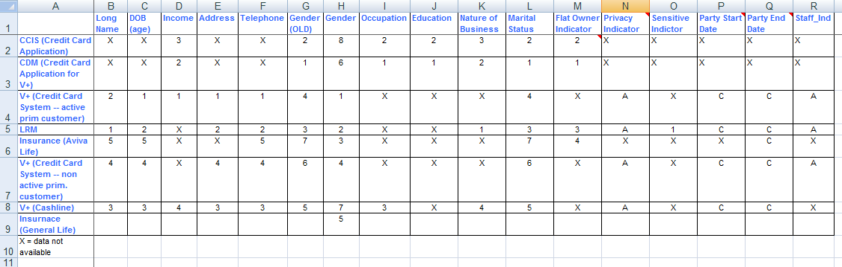
Party
Selection logic:

Slide 24
Party_addr
Selection logic:
PRIORITY SYSTEM
-------- -------------------------------
1 V+ (CREDIT CARD SYSTEM -- WITH ACTIVE PRIM. CARD)
2 RM BANK PARTY (DHB)
3 CASHLINE (CSHLINE_PARTY)
4 V+ (CREDIT CARD SYSTEM -- WITHOUT ACTIVE PRIM. CARD)
- CCIS (CREDIT CARD APPLICATION)
Document_Nbr | Document_Id_Type_Code | Country_Of_Issue | Addr_Use_Code | Addr_Line_1 | Addr_Line_2 | Addr_Line_3 | Addr_Line_4
CSVUC10070 | 2 |  | M | LEVEL 13 | MILLENNUM CITY 6 | 352 KWUN TONG ROAD | KWUN TONG KOWLOON
Z6675027 | B | CN | M | ROOM H 27/F | BLOCK 1 | LOK HIN TERRACE | CHAI WAN HK

Slide 25
Party_phone
Selection logic:
PRIORITY SYSTEM
-------- -------------------------------
1 V+ (CREDIT CARD SYSTEM - ACTIVE PRIM CARD)
2 RM BANK PARTY
3 CASHLINE
4 V+ (CREDIT CARD SYSTEM - NON ACTIVE PRIM CARD)
- CCIS (CREDIT CARD APPLICATION)
5 AVIVA LIFE
6 MANULIFE MLI
7 AVIVA GI
Document_Nbr | Document_Id_Type_Code | Country_Of_Issue | Phone_Type_Code | Phone_Nbr | Phone_Ext | Phone_accepted_ind
P3094263 | 1 |  | R | 23924532 | ? | N
A9438311 | 1 |  | M | 93562992 | ? | N

Slide 26
Gen. SCV report to downstream system
1. Generate party information report
2. Generate active party account information report
3. Generate active account balance amount report
including loan, deposit, unit trust, credit card, securities and insurance

Slide 27
Part 2 Data Mart Instruction
Unica Data Mart
CRM Data Mart

Slide 28
Unica Data Mart
Unica data mart Instruction
Unica Campaign
Campaign Management
Vendor Management

Slide 29
Logical Diagram for GAS(Unica)
C:D Staging Server(W)
Hong Kong Mainframe (H)
GAS(Unica)
SSH
C:D
UNICA
(1)
CLI
HK Teradata DB Server
Unica
Data Mart
GDW DB
ODBC

Slide 30
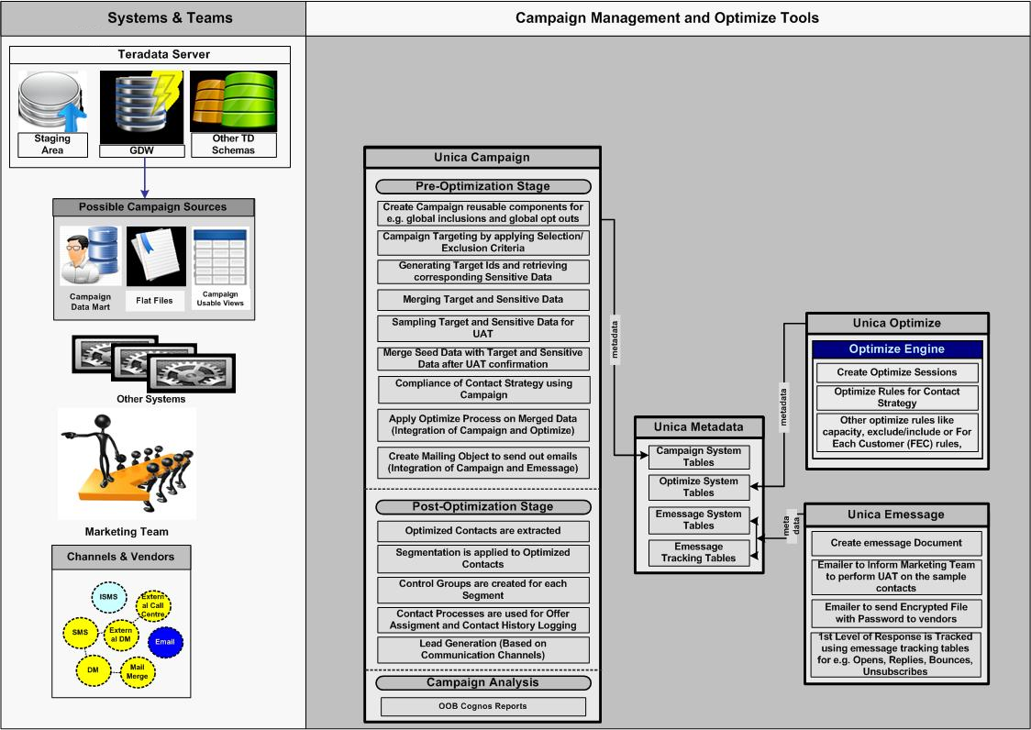
Unica Campaign Instruction

Slide 31
CRM Data Mart
CRM Data Mart Instruction
Microsoft Dynamics Customer Relationship Management (CRM)
Customer Management
Service Management
Marketing Management
Product Management

Slide 32
Logical Diagram for GAS(CRM)
Hong Kong Mainframe (H)
GAS(CRM)
C:D
CRM
C:D
CLI
HK Teradata DB Server
CRM
Data Mart
GDW DB

Slide 33
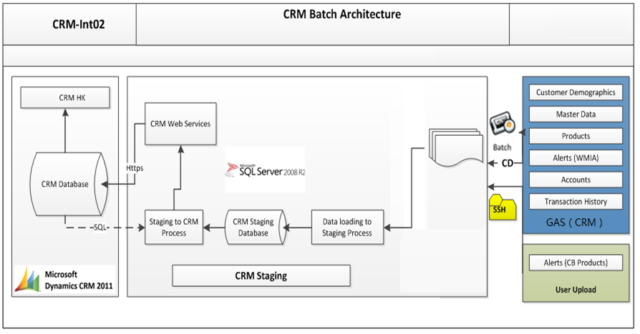
CRM Batch Architecture

Slide 34
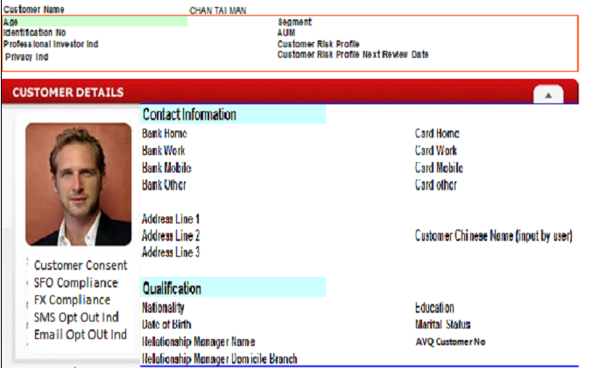
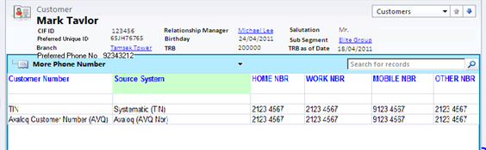
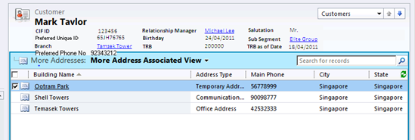
Customer Demographics
Customer Overview
General Information
Contact Information
Qualification
More phone
More address

Slide 35
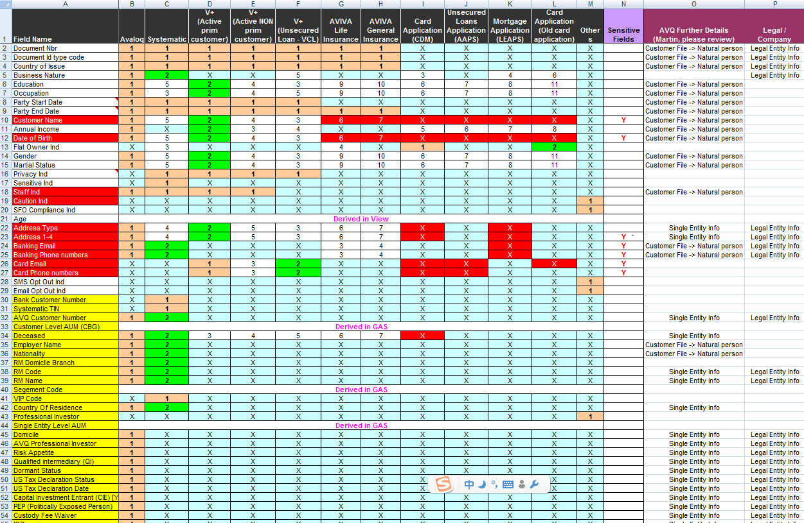
Customer information selection

Slide 36
Product and account
Cash
Total Investment Portfolio
Secured Loans
Unsecured Loans
Other Cash Investment
Credit Card
Total Insurance Portfolio
Trade Finance
Segment
Self-Service Channels

Slide 37
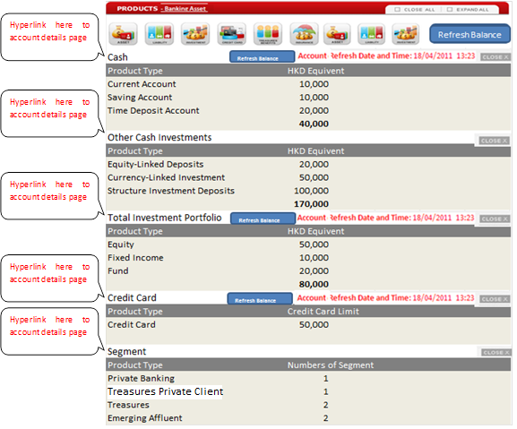
Account Details

Slide 39
Master Data
There are 30 reference tables.
1 Address Type
2 Phone Type
3 Country
4 Branch
6 Officer Name
7 Document Type
8 Marital Status
……

Slide 40
Alerts
Alerts List
Birthday Reminder Alert
Deceased Alert
Staff Alert
Return mail status Alert
TD/SP Maturity
Expire PI(professional Investment) Status Alert

Slide 41
Part 3 Big Data Instruction
Hadoop Ecosystem
BIP Regional Architecture
Banking Analytical Models and Use Cases

Slide 42
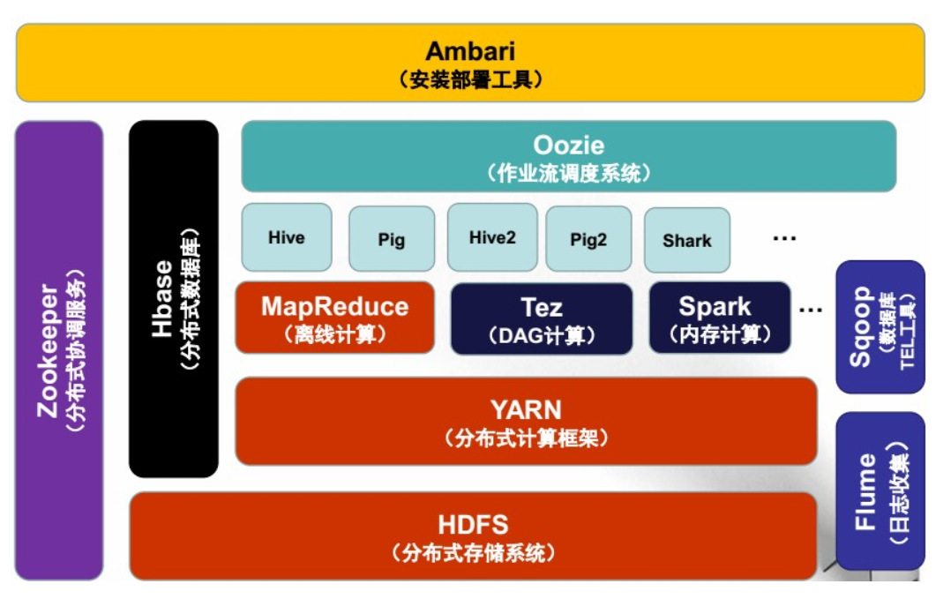
Hadoop Ecosystem
Notes:
MapReduce "Map（映射）"和"Reduce（归约）“ :映射和化简
1、Hadoop 是一个能够对大量数据进行分布式处理的软件框架。具有可靠、高效、可伸缩的特点。Hadoop的核心是HDFS和Mapreduce，hadoop2.0还包括YARN。
2、HDFS Hadoop的分布式文件系统。是Hadoop体系中数据存储管理的基础。它是一个高度容错的系统，能检测和应对硬件故障，用于在低成本的通用硬件上运行。HDFS简化了文件的一致性模型，通过流式数据访问，提供高吞吐量应用程序数据访问功能，适合带有大型数据集的应用程序。
3、MapReduce（分布式计算框架） MapReduce是一种计算模型，用以进行大数据量的计算。其中Map对数据集上的独立元素进行指定的操作，生成键-值对形式中间结果。Reduce则对中间结果中相同“键”的所有“值”进行规约，以得到最终结果。MapReduce这样的功能划分，非常适合在大量计算机组成的分布式并行环境里进行数据处理。
4、Hive（基于Hadoop的数据仓库）Hive定义了一种类似SQL的查询语言(HQL),将SQL转化为MapReduce任务在Hadoop上执行。通常用于离线分析。
5、Hbase（分布式列存数据库） HBase是一个针对结构化数据的可伸缩、高可靠、高性能、分布式和面向列的动态模式数据库。和传统关系数据库不同，HBase采用了BigTable的数据模型：增强的稀疏排序映射表（Key/Value），其中，键由行关键字、列关键字和时间戳构成。HBase提供了对大规模数据的随机、实时读写访问，同时，HBase中保存的数据可以使用MapReduce来处理，它将数据存储和并行计算完美地结合在一起。
6、Zookeeper（分布式协作服务） 解决分布式环境下的数据管理问题：统一命名，状态同步，集群管理，配置同步等。
7、Sqoop（数据同步工具） Sqoop是SQL-to-Hadoop的缩写，主要用于传统数据库和Hadoop之前传输数据。数据的导入和导出本质上是Mapreduce程序，充分利用了MR的并行化和容错性。
8、Pig（基于Hadoop的数据流系统） 由yahoo!开源，设计动机是提供一种基于MapReduce的ad-hoc(计算在query时发生)数据分析工具。定义了一种数据流语言—Pig Latin，将脚本转换为MapReduce任务在Hadoop上执行。通常用于进行离线分析。
9、Flume（日志收集工具） Cloudera开源的日志收集系统，具有分布式、高可靠、高容错、易于定制和扩展的特点。 它将数据从产生、传输、处理并最终写入目标的路径的过程抽象为数据流，在具体的数据流中，数据源支持在Flume中定制数据发送方，从而支持收集各种不同协议数据。同时，Flume数据流提供对日志数据进行简单处理的能力，如过滤、格式转换等。此外，Flume还具有能够将日志写往各种数据目标（可定制）的能力。总的来说，Flume是一个可扩展、适合复杂环境的海量日志收集系统。
10、Oozie作业流调度引擎 Oozie是一个基于工作流引擎的服务器，可以在上面运行Hadoop的Map Reduce和Pig任务。它其实就是一个运行在Java Servlet容器（比如Tomcat）中的Javas Web应用。
11、Spark 是一个新兴的大数据处理通用引擎，提供了分布式的内存抽象。Spark 正如其名，最大的特点就是快（Lightning-fast），可比 Hadoop MapReduce 的处理速度快 100 倍。此外，Spark 提供了简单易用的 API，几行代码就能实现 WordCount。本教程主要参考官网快速入门教程，介绍了 Spark 的安装，Spark shell 、RDD、Spark SQL、Spark Streaming 等的基本使用。
12、YARN （Yet Another Resource Negotiator，另一种资源协调者）是一种新的 Hadoop 资源管理器，它是一个通用资源管理系统，可为上层应用提供统一的资源管理和调度，它的引入为集群在利用率、资源统一管理和数据共享等方面带来了巨大好处。

Slide 43
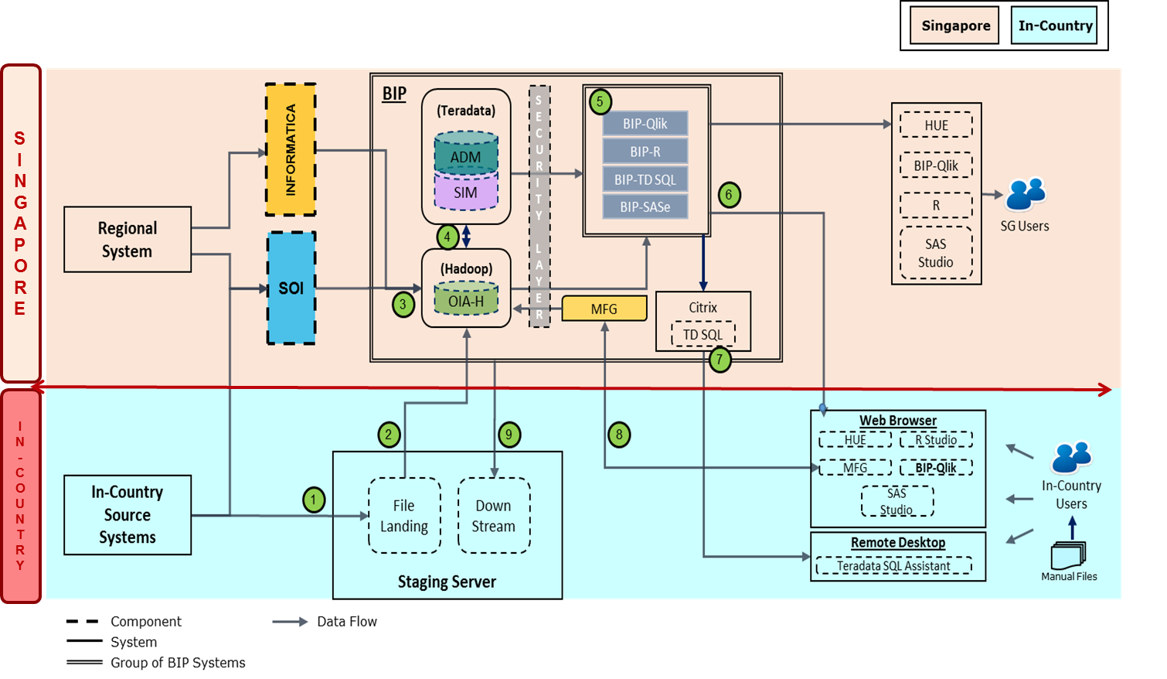
BIP Regional Architecture
Data from Regional systems (hosted in SG) will be loaded into BIP-Hadoop via SOI layer and Informatica (batch).
All Regional data stored on local staging server will be loaded into BIP-Hadoop.
Integrated Data will be loaded into BIP-Teradata for SIM and purpose built ADM.
QlikView and SASe will access data residing in both Teradata & Hadoop. R will have access to data from Hadoop.
Access for in-country users via web-browser will be for analytics and reporting tools.
Access to Teradata SQL for in-country users will be via Citrix (residing in SG).
Manual in-country data will be loaded into BIP through Manual File Gateway (MFG) accessible via web-browser.
Downstream data will be pushed to In-Country Source system directly or via Staging Server.
Data from in-country source systems will be loaded via SOI OR local Staging server before being loaded into Hadoop.

Slide 44
GDW Online User Views Enablement in BIP
BIP ETL Framework Process pull the file, process to OIA-A; later Loads data to Hadoop (OIA-H); Hive DB maintain History of Source
Extract the data from Hive using SQL Scripts, these scripts logic will be inline to SIM Model
New/Change records will get loaded to WorkDB thru ETL Framework
Change/New records will get loaded to BIP SIM
Use Data Virtualization tool to deploy the views which would connect to heterogeneous databases
Teradata
Hadoop - Hive
HK Users Access the View DB thru Security Matrix
SG Open Systems
C:D/
SSH
BIP
OIA-A
BIP
OIA-H
BIP
TXFDB
BIP
WorkDB (Teradata)
BIP
SIM
1
2
3
4
HK Staging Server
SSH
ETL
Framework
SQL
Scripts
(inline to GDW scripts)
ETL
Framework
ETL
Framework
SG MF
Wire Protocol
C:D
5.1
HK MF
5.2
Data Virtualization
HK User
ViewDB 1
6
ViewDB 2
ViewDB n
Mainframe
GDW
Open Systems
Data Virtualization
HK Staging
BIP File Landing
Manulife
OnDemand Server
BIP
ViewDB

Slide 45
Model Benefit / Complexity Matrix
Complexity
ATM Cash Forecasting
Workforce Planning
Offer Optimization
Cash Flow
Attrition
Social & Sentiment
Web and Mobile
Credit Scoring
Call Center
Cross / Up Sell
Fraud
Micro Segmentation
AML
Value Add

Slide 46

Customer & Marketing Analytics – Micro Segmentation
What
Segment the customers into Distinct and Detailed Categories
How
Use Clustering on 360º view of Customer covering Demographics, Transactions and Social Profiles
Benefits
Helps pitch a product that relates specifically to that Segment
Helps penetrate the market niches to a greater extent
Notes:
客户细分
根据客户的概貌，历史交易和社交信息，进行客户画像，贴标签，有助于推销特定于该部分的产品，低价值客户，潜在价值客户，次价值客户，高价值客户

Slide 47

Customer & Marketing Analytics – Cross Sell / Up Sell
What
Identify Combination of Products where Purchasing one usually Leads to Purchasing the Other
How
Use Correlation Analysis between Products
Benefits
Increase Take Rate of Campaigns
Control the offers made to customers and avoid spamming customers with non productive campaigns
Identify the next Logical Product to be offered to the customer that has the highest Take Rate
Use Product Purchase Event History to Model When and Which Product should be offered
Notes:
交叉销售 个性化服务和咨询推荐
根据客户使用银行产品和服务的历史信息及在银行官网/APP留下的实时信息，利用大数据文本分析和挖掘技术，分析客户的长期、短期偏好和需求，预测当下和潜在偏好和需求，为客户推荐个性化服务或资讯
交叉行销（cross-sell）借助CRM(客户关系管理)，发现有顾客的多种需求，并通过满足其需求而销售多种相关服务或产品的一种新兴营销方式。
本来是来办理存款的结果被忽悠成购买理财产品了
向上行销（up-sell）：是一种发现顾客多种需求，并满足其多种需求的营销方式，从横向角度开发产品市场，是营销人员在完成本职工作以后，主动积极的向现有客户、市场等销售其他的、额外的产品或服务

Slide 48

Channel Management – Call Center
What
How
Benefits
Reduce Call Volumes
Analyze Frequent Call Center Call Reasons, Analyze Events that Lead Up to the Call
Manage Call Center Workforce by Forecasting Call Volumes
Access Call Center Logs and Mine the Free Text Comments
Use Link Analytics to identify sequence of events that lead up to the call
Use NLP to analyze and identify Products and Sentiments from Call Center Comments
Notes:
帮助银行从采集的客音数据、问卷调查、互联网舆情等数据分析客户的抱怨、诉求和需求，
从而为客户制定有针对性的服务策略。通过分析客音数据，挖掘客户对产品的诉求和抱怨信
息，在后续和客户接触时，提供更符合客户预期的信息。基于360°用户统一视图，客服人
员能全方位了解客户的基本信息、购买历史、投诉历史等，从而可以给客户推荐更合适的产品

Slide 49

Risk & Fraud Analytics – Fraud
What
How
Identify which Transactions are Suspicious and either Flag them for Analysis or Block them
Capture customers Locations, Networks, WIFI, Mobile MAC, etc and History of Transactions and Transaction Volume
Reduce Fraud, Track Fraudulent Customers, IP, MAC, WIFI etc to maintain a Black List
Identify Transactions from new/unknown locations or deviating from past Transaction History for possible Fraud
Benefits
Improve Customer Satisfaction and safeguard Customers Intrests

Slide 50

Operational Analytics – ATM Cash Optimization
What
How
Forecast When, Which and How much Cash is required at a ATM
Benefits
Ensure that ATM Machines are never out of Cash, Save on un-used Cash lying in ATM Machines
Use Shortest Path Algorithms to plan the Cash Van’s Route
Optimize ATM Van Route Plans
Optimize ATM Cash Team Schedules and Routes for Optimum Usage
Model on ATM Usage Stats and Denominations to know the Cash Requirements
Notes:
现金管理
利用机器学习和人工智能技术，通过对客户在ATM的现金流转的周期性规律分享，帮助客户更好的预测
和规划ATM现金准备，从而满足银行用户现金需求的条件下，实现渠道现金部署的最小化，从而显著降低不生
息的现金使用，实现资产安排和收益最大化。同时优化ATM现金押运车路线方案

Slide 51

Thank You

